Slide 1
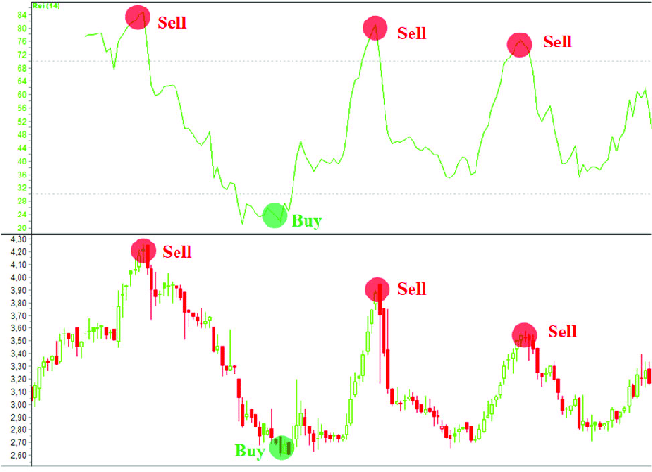
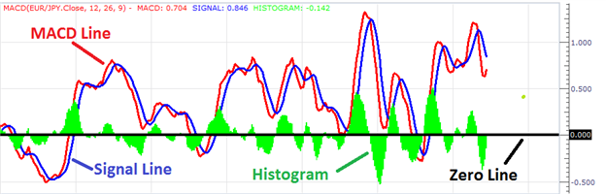
Download stock data and plot MACD & RSI

Slide 2
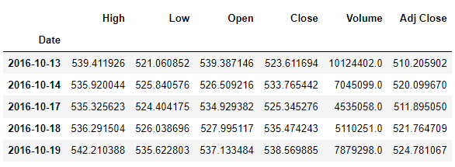
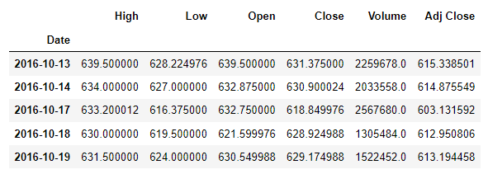
Download stock data
# Import necesary libraries
import pandas_datareader.data as pdr
import datetime
import matplotlib.pyplot as plt
# Download historical data for required stocks
ticker = "RELIANCE.NS"
ohlcv = pdr.get_data_yahoo(ticker,datetime.date.today()-datetime.timedelta(1825),datetime.date.today())
ohlcv.head()
# Download historical data for required stocks
ticker = "HDFCBANK.NS"
ohlcv = pdr.get_data_yahoo(ticker,datetime.date.today()-datetime.timedelta(1825),datetime.date.today())
ohlcv.head()

Slide 3
Function to find Moving Average Convergence Divergence (MACD) signal
def MACD(DF,a,b,c):
"""function to calculate MACD
typical values a = 12; b =26, c =9"""
df = DF.copy()
df["MA_Fast"]=df["Adj Close"].ewm(span=a,min_periods=a).mean()
df["MA_Slow"]=df["Adj Close"].ewm(span=b,min_periods=b).mean()
df["MACD"]=df["MA_Fast"]-df["MA_Slow"]
df["Signal"]=df["MACD"].ewm(span=c,min_periods=c).mean()
df['Day2_Close'] = df['Adj Close'].shift(-1)
df['Day3_Close'] = df['Adj Close'].shift(-2)
df['Day4_Close'] = df['Adj Close'].shift(-3)
df['Day5_Close'] = df['Adj Close'].shift(-4)
df['Day6_Close'] = df['Adj Close'].shift(-5)
#df['MACD-Signal'] = df["MACD"] - df["Signal"]
df['Avg_Close'] = (df['Day2_Close'] + df['Day3_Close'] + df['Day4_Close'] + df['Day5_Close'] + df['Day6_Close'])/5
df['PL'] = df['Avg_Close'] - df['Adj Close']
df.dropna(inplace=True)
data=df.copy()
data.reset_index(inplace = True)
fig = go.Figure(data=[go.Candlestick(x=data['Date'], open=data['Open'], high=data['High'], low=data['Low'], close=data['Close'])])
fig.show()

Slide 4
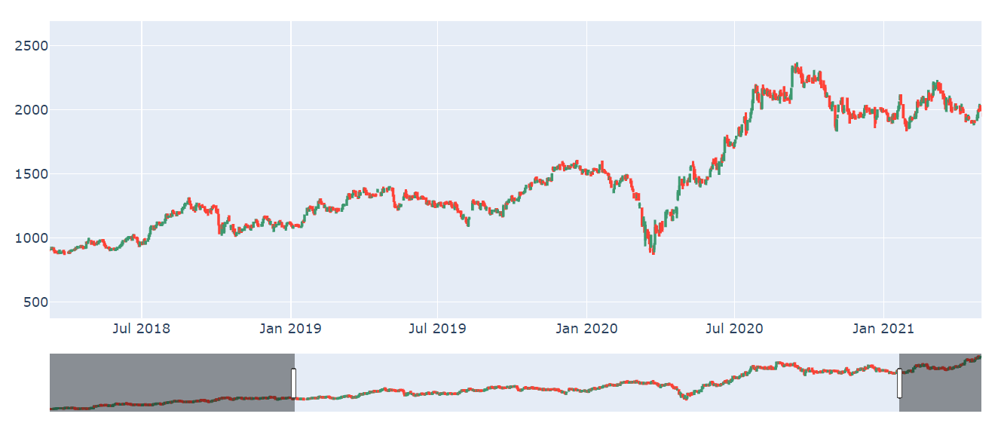
Candle Chart of MACD signal

Slide 5
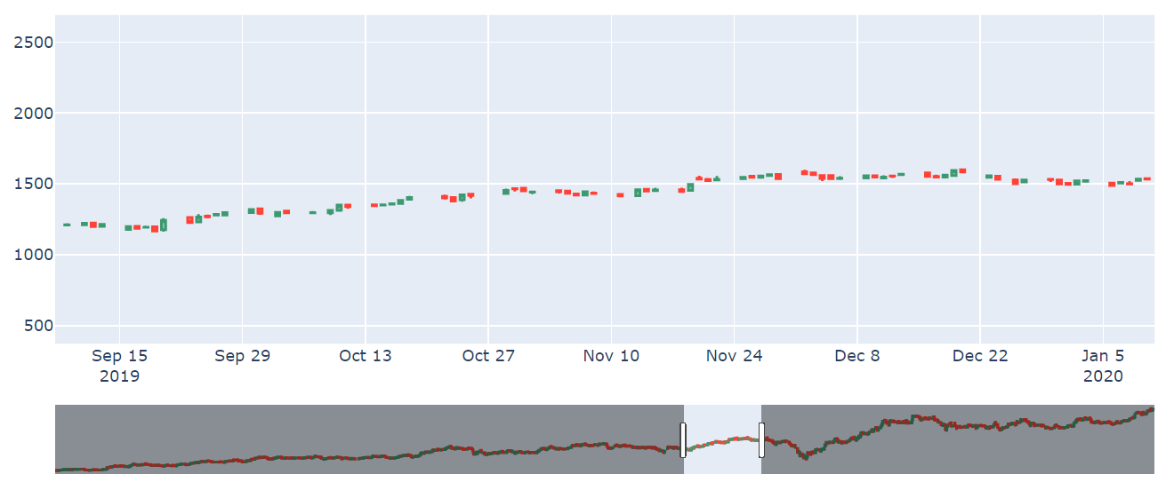
Candle Chart of MACD signal

Slide 6
Function to find RSI indicator
def RSI(DF,n):
"function to calculate RSI"
df = DF.copy()
df['delta']=df['Adj Close'] - df['Adj Close'].shift(1)
df['gain']=np.where(df['delta']>=0,df['delta'],0)
df['loss']=np.where(df['delta']<0,abs(df['delta']),0)
avg_gain = []
avg_loss = []
gain = df['gain'].tolist()
loss = df['loss'].tolist()
for i in range(len(df)):
if i < n:
avg_gain.append(np.NaN)
avg_loss.append(np.NaN)
elif i == n:
avg_gain.append(df['gain'].rolling(n).mean().tolist()[n])
avg_loss.append(df['loss'].rolling(n).mean().tolist()[n])
elif i > n:
avg_gain.append(((n-1)*avg_gain[i-1] + gain[i])/n)
avg_loss.append(((n-1)*avg_loss[i-1] + loss[i])/n)
df['avg_gain']=np.array(avg_gain)
df['avg_loss']=np.array(avg_loss)
df['RS'] = df['avg_gain']/df['avg_loss']
df['RSI'] = 100 - (100/(1+df['RS']))
df.dropna(inplace=True)
data=df.copy()
data.reset_index(inplace = True)
fig = go.Figure(data=[go.Candlestick(x=data['Date'], open=data['Open'], high=data['High'], low=data['Low'], close=data['Close'])])
fig.show()
return df['RSI']

Slide 7
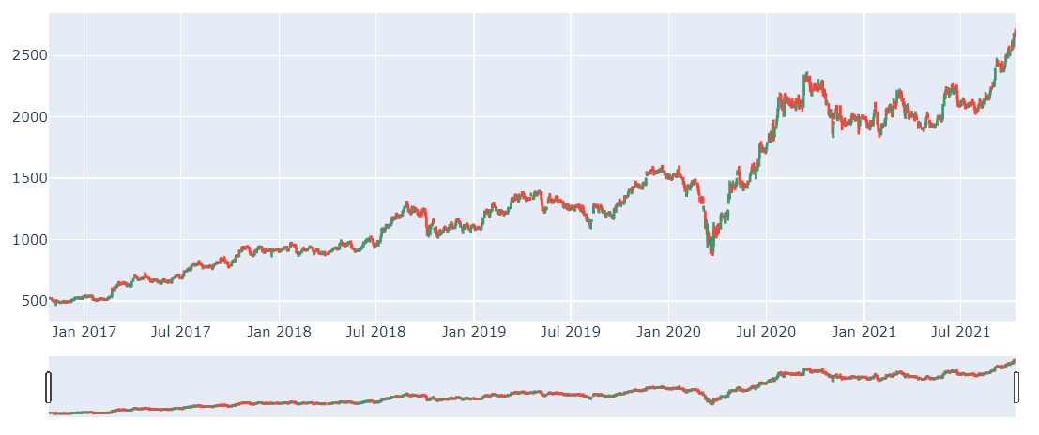
Candle Chart of RSI Indicator

Slide 8
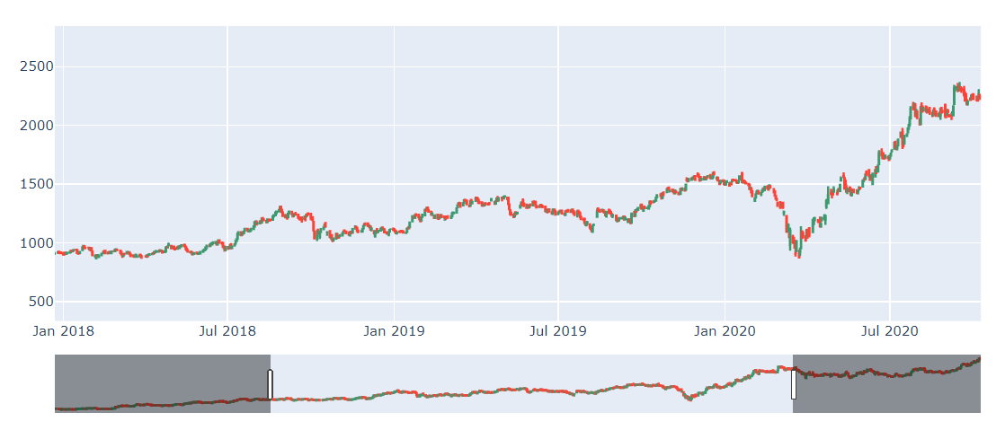
Candle Chart of RSI Indicator

